Slide 1
74th Annual General Meeting
July 17, 2017
Financial Year 2016-17
Presented by
Sanjiv Sarin
Managing Director & CEO

Slide 2
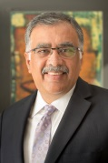
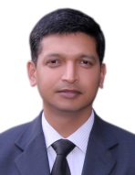
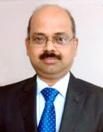
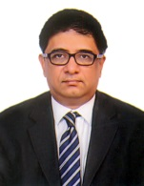
Leadership Team
Managing Director
Mr Sanjiv Sarin
Executive Director &
CFO
Mr. K.
Venkataramanan
Executive Director
Mr. T.
Radhakrishnan
Executive Director &
Dy. CEO
Mr. Chacko P.
Thomas

Slide 3
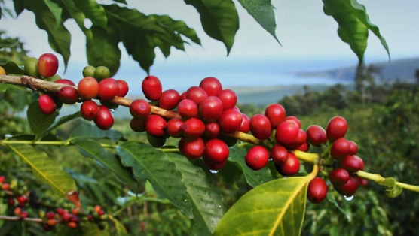
Category Overview
Green Bean
155
Balanced overall supply and demand – though wide variance between Arabica and Robusta
Million bags (2016)
Arabica production at an all-time high
Robusta production lowest in 5 years
Instant Coffee
More than 20% of global consumption
Asia and Africa to be key growth markets
Steady consumption growth expected
Shift towards IC in non-traditional markets

Slide 4
Global Markets
Terminals have been volatile, reflecting currency & crop patterns
9%
USD/MT
c/lb
43%
Robusta
Arabica
Source: International Coffee Organization

Slide 5
Financial Highlights (Standalone)*
Strong performance
Amidst volatile conditions.
Turnover INR Crs
Profit After Tax INR Crs
* FY 15-16 and 16-17 numbers are Ind AS adjusted and not comparable with earlier year’s financials

Slide 6
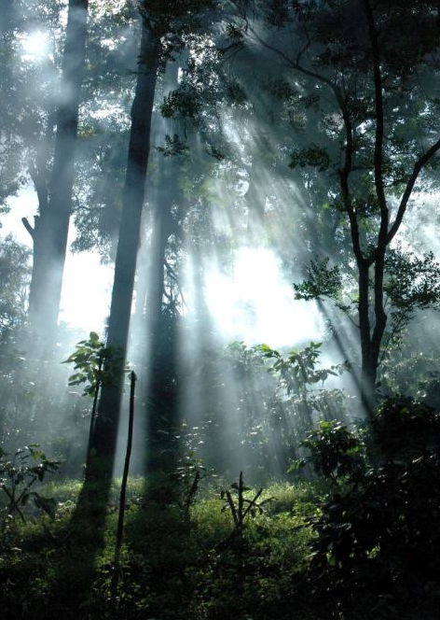
Re-crafted Mission and Values
Create distinctive long-term value for all stakeholders with Coffee and Allied Plantation products embracing sustainable practices
Customer Focus
Innovation & Agility
People Centric
Responsibility
Transparency
Mission
Values
Disintermediate
Differentiate
Premiumize
Focus

Slide 7
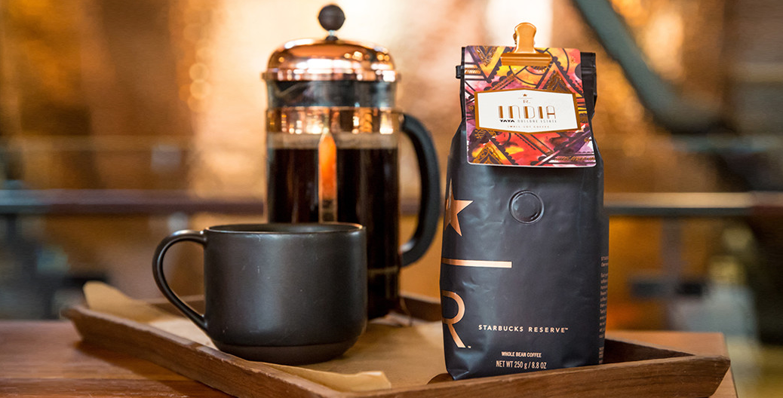
Key Focus Areas and Operating Highlights
1
Customer Focus
Nullore – the first-ever Indian origin coffee to be curated by Starbucks ‘Reserve’
Co-creating soluble coffee blends with inputs from key customers, specially in Africa
Significantly increased front end customer interface for quality and new product teams
Increased customer interface with plantations and production sites

Slide 8
Key Focus Areas and Operating Highlights
2
Differentiation
Increased by
over 50%*
Disintermediation
Increased by
over 100%*
Premiumization
Expansion of monsooning facility
Focus on single-estate sales
Small-lots and certified coffee sales
Understanding the customer, quality, sustainability and traceability have been at the core.
*Increase over the last two years

Slide 9
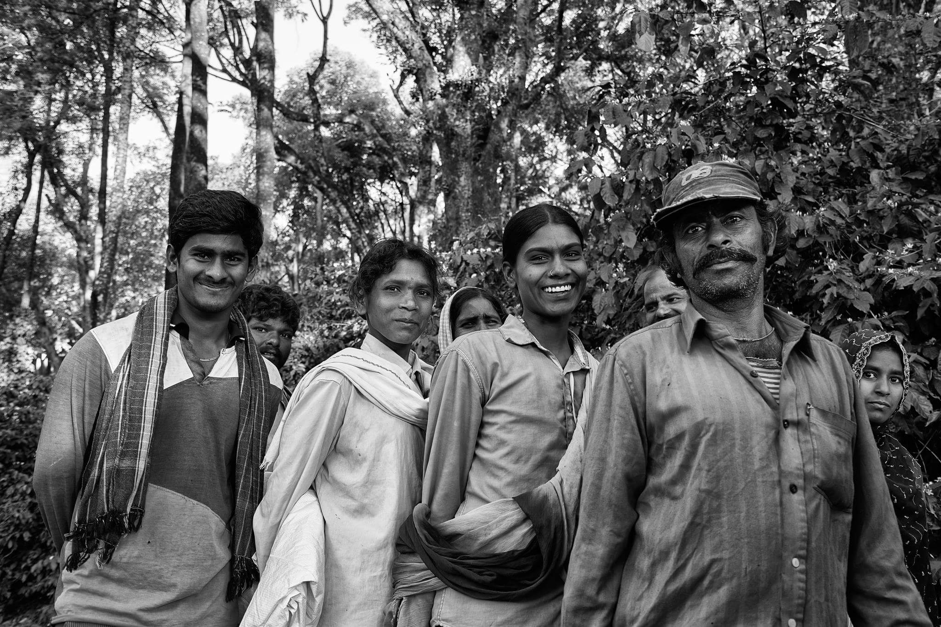
Beyond the P&L
Won CII National Safety Award for work done on mitigating human-animal conflict in the region
Awarded Most Ethical Company in Agriculture by World Quality Congress
SEEM National Award for energy management at Theni
Continual support to Swastha and RIHP
CSR program focused on water conservation projects and skill development programs for women empowerment
3
Sustainability
&
Responsibility
Sustainability and our communities have been central to us

Slide 10
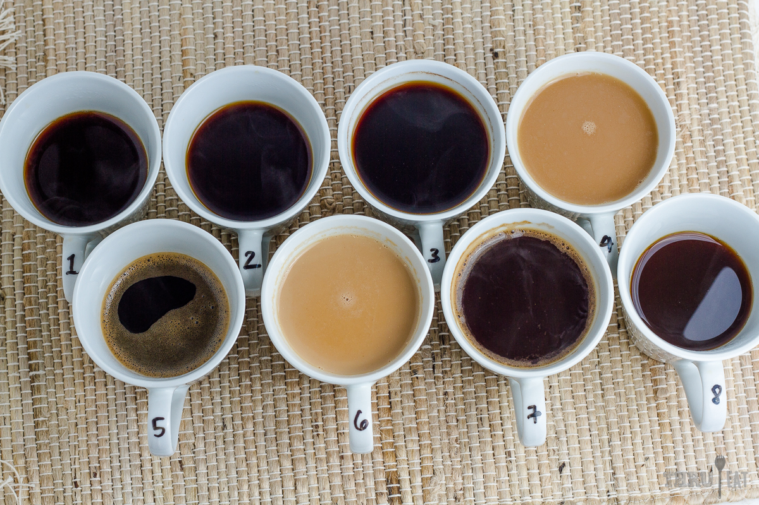
Divisional Highlights
Plantations Division
‘Nullore’ to Starbucks ‘Reserve’
Focused on maintaining bush health and protecting crop in a year that received 46% less rainfall.
Created 100% irrigation capacity through rainwater harvesting tanks
Five estates bagged Regional and Specialty Fine Cup awards
Instant Coffee Division
Over 60% energy consumption in Theni is from renewable resources
Focused on new product variants for select markets and customers
State of the art greenfield FDC project in Vietnam approved
Achieved highest ever sales volume

Slide 11
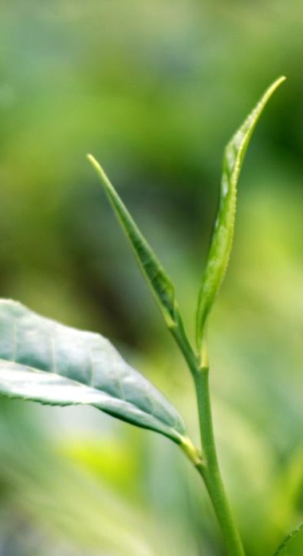
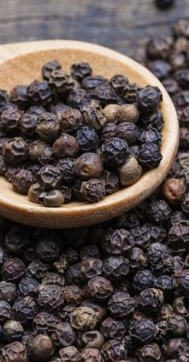
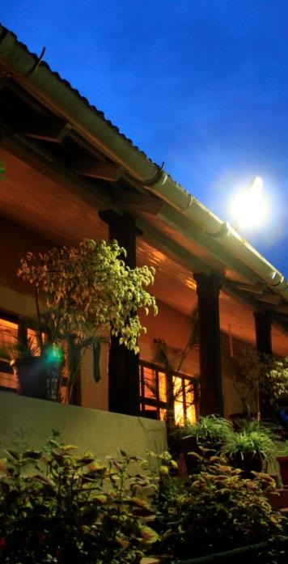
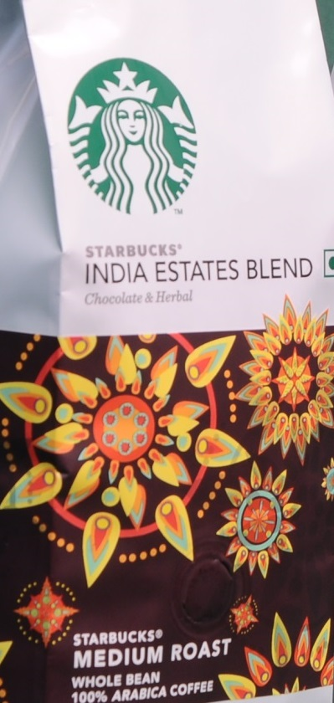
Divisional Highlights
Tea
Pepper
Plantation Trails
Starbucks Roastery
Focused on crop health to mitigate sparse rainfall. Aggressive extension into Orthodox Tea.
Winner – TripAdvisor ‘Certificate of Excellence’. New Website launched.
Qualified for roasting select International Beans for the Indian market
Upgraded processing center and focus on disintermediation.

Slide 12
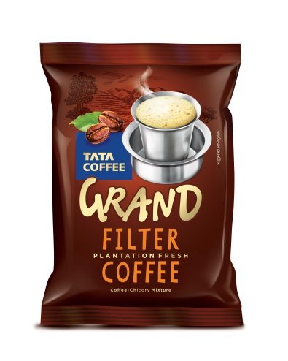
Tata Coffee Grand
Marketed and distributed by
Tata Global Beverages
Introduced Hot Tea Shop and R&G (Filter Coffee with Chicory) blends
Tata Coffee Grand has been well received by the consumers

Slide 13
People & Capability
Key management personnel hired in customer-facing roles
Move towards a performance-driven organization
Focus on strong execution

Slide 14
Eight ‘O’ Clock
Recorded 37% increase in PAT driven by lower costs
Bag volumes marginally up though k-cup pod volumes are impacted by intense competitive pressure
Strong focus on new product development
Launched new ‘Infusions’ line of coffee
Launched new Brazilian Breakfast blend

Slide 15
Consolidated Performance (FY 16-17) and Market Cap
Share Price (Closing)*
Revenue from Operations (Consolidated)
INR
1606
Cr
FY 16-17
Profit After Tax (Consolidated)
Market Capitalization (INR Cr)
INR
151
Cr
*share price adjusted for face value of INR 1 per share. Prices taken as on 31st March closing for the year.
Notes:
Update latest share price

Slide 16
End of Deck

